Slide 1
Microsoft 365 Enterprise
Licensing overview
January 2023
Latest diagrams available here:
https://m365maps.com

Slide 2
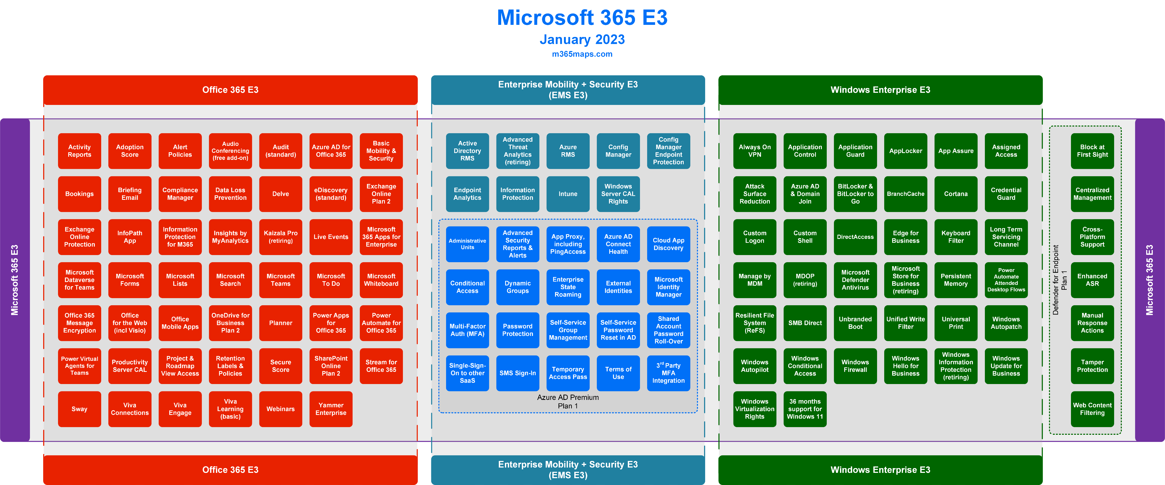

Slide 3
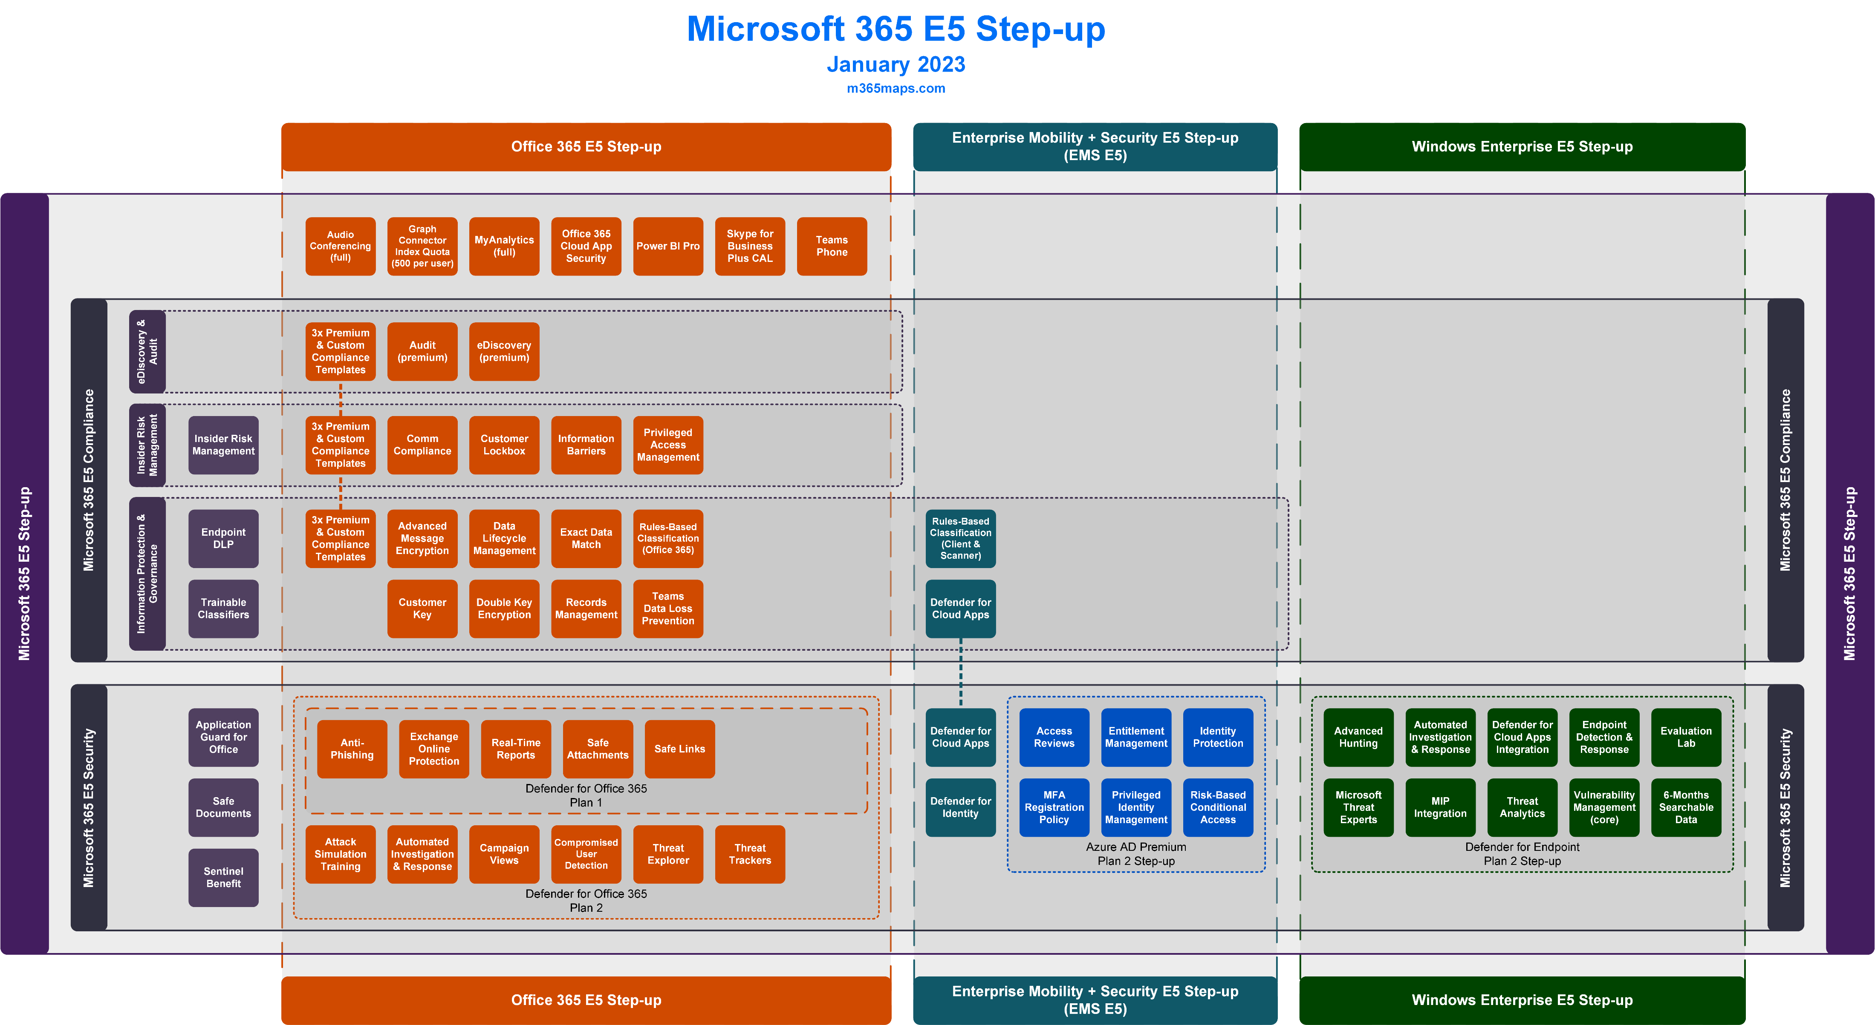

Slide 4
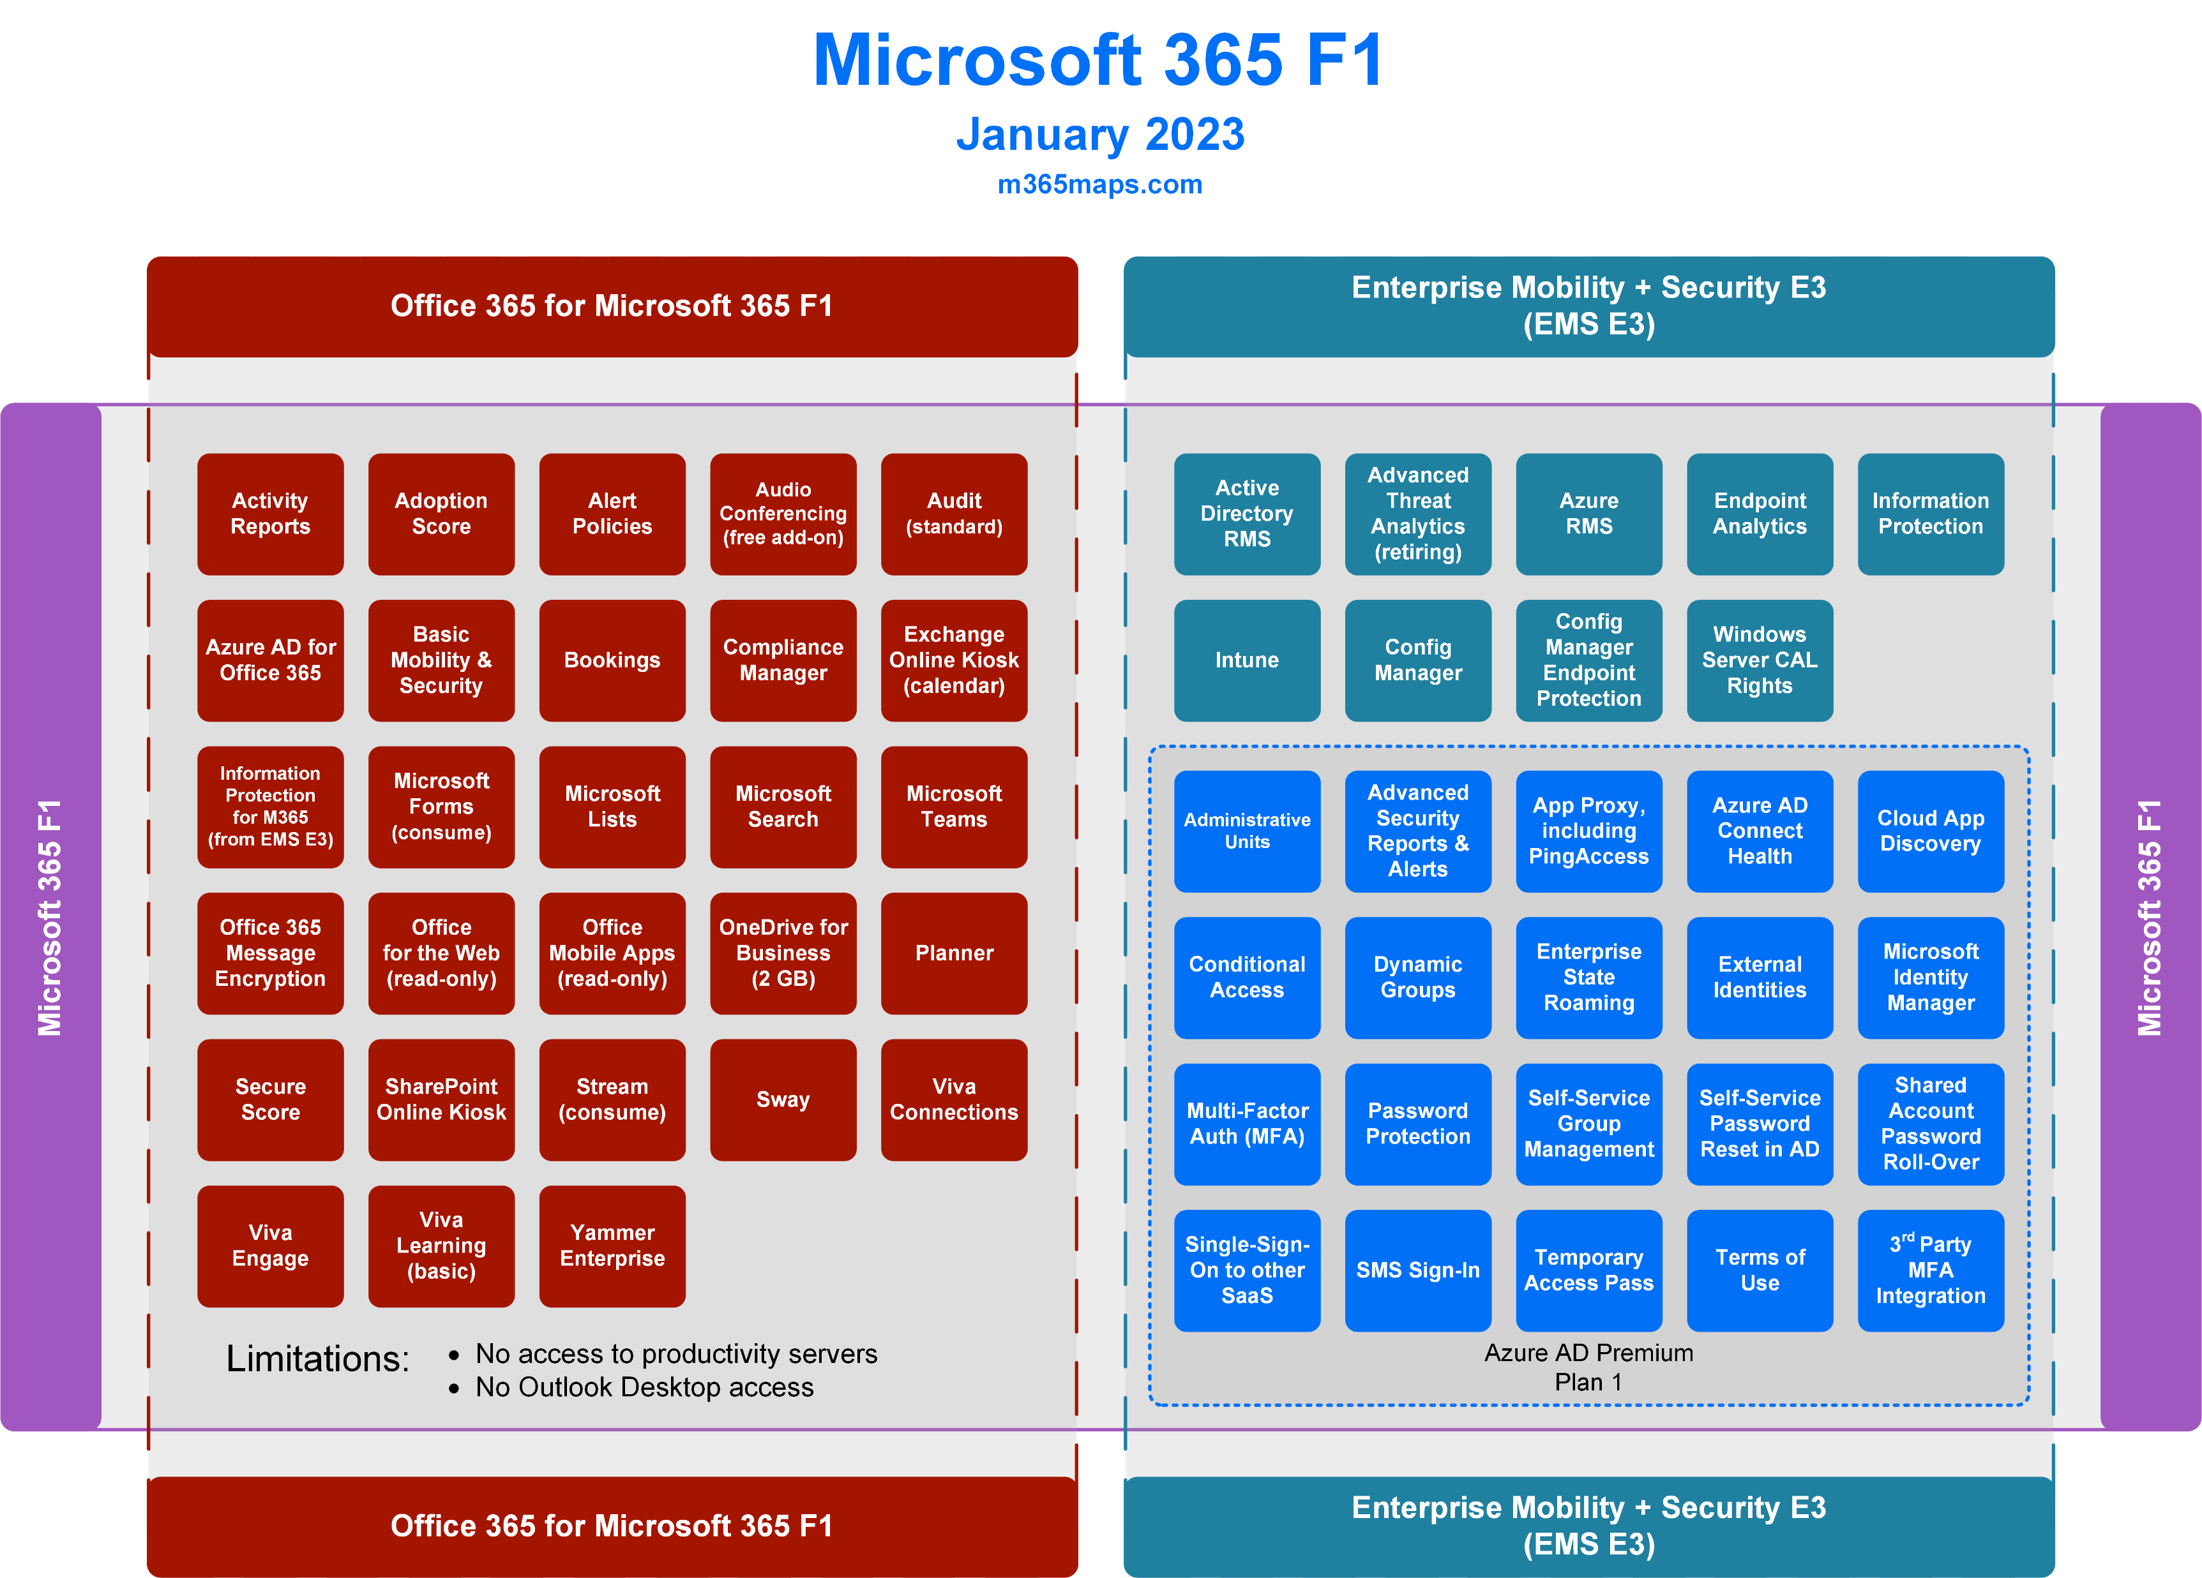

Slide 5
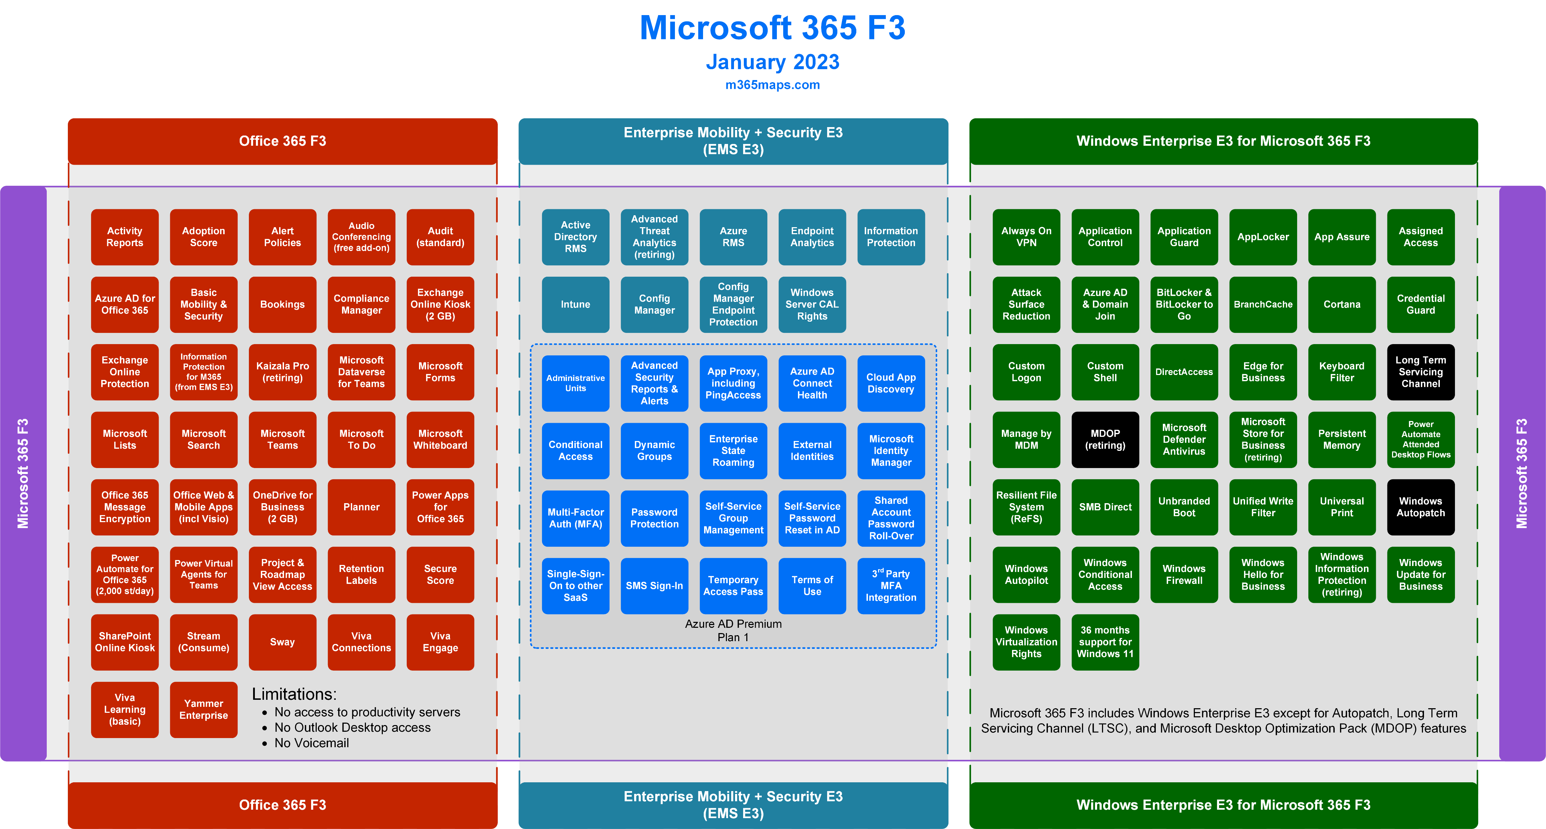

Slide 6
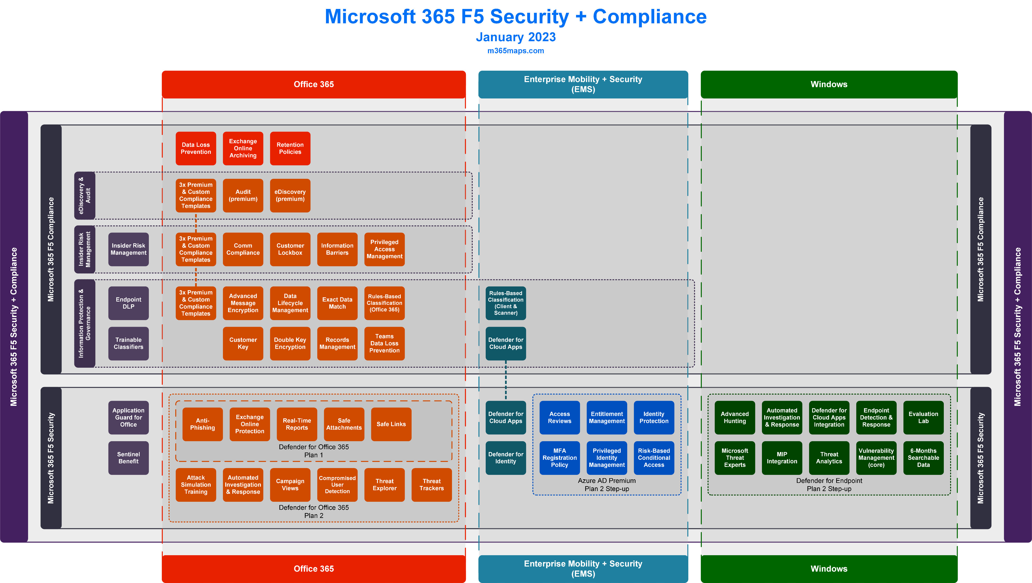

Slide 7
Microsoft 365 Business
Licensing overview
January 2023
Latest diagrams available here:
https://m365maps.com

Slide 8
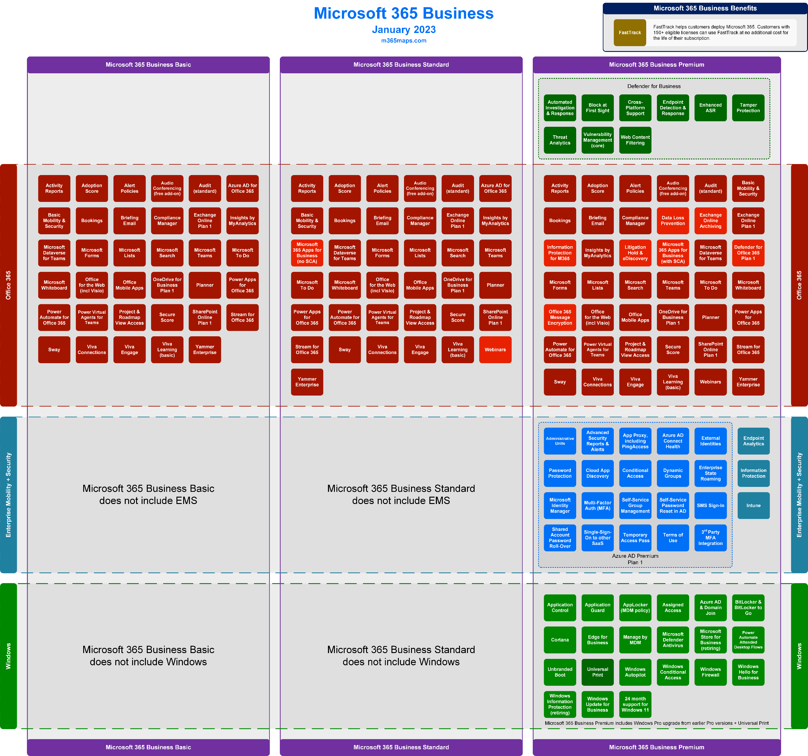

Slide 9
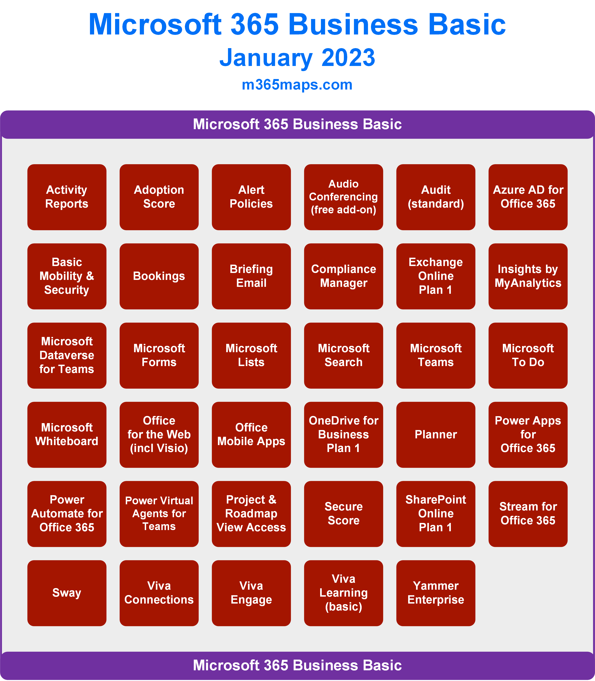

Slide 10
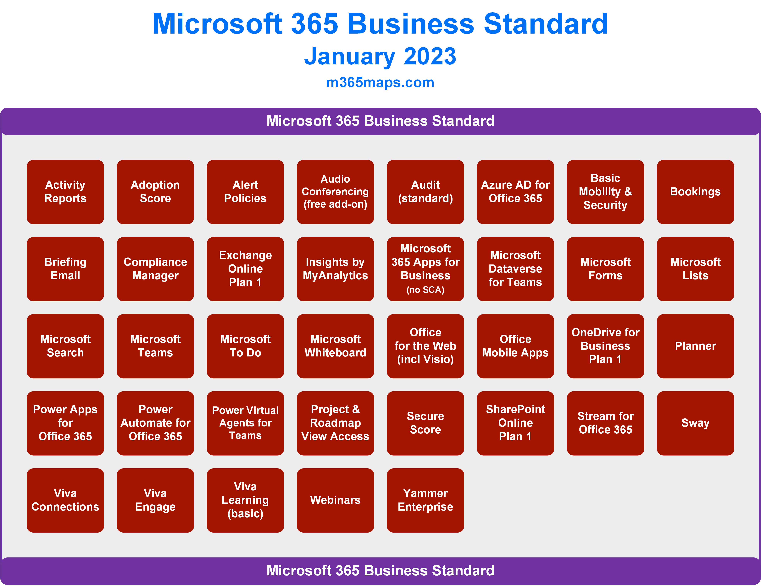

Slide 11
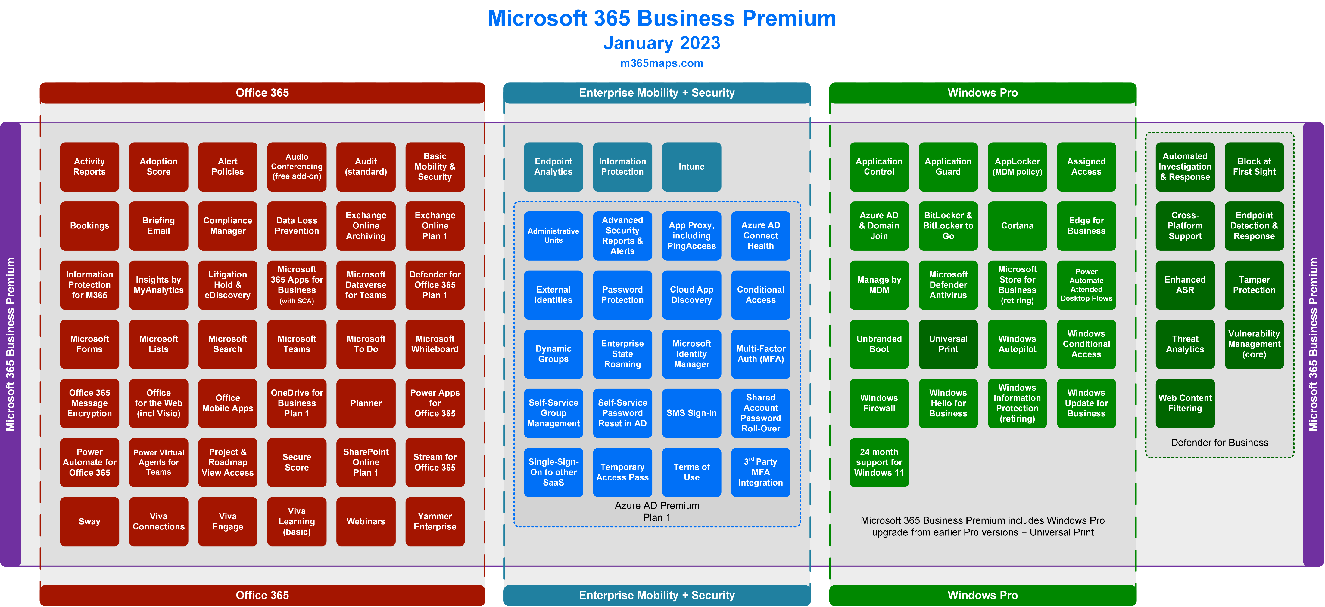

Slide 13
Website https://m365maps.com GitHub https://github.com/AaronDinnage/Licensing Updates on Twitter and LinkedIn https://twitter.com/AaronDinnage https://www.linkedin.com/in/aarondinnage/

